Slide 1




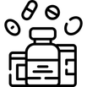

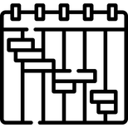
One Slider
OBJECTIVE
STAKEHOLDERS
Context: What business problem exists today? (manual process, delays, compliance risk, lack of visibility, etc.)
Objective: Introduce AI-based demand forecasting to reduce stock-outs and improve production planning accuracy.
Supply Chain, Manufacturing, Quality Assurance, R&D, Regulatory, Commercial, IT
BENEFITS
APPROACH & SOLUTION DESIGN
Qualitative: Better decision transparency
Faster investigation cycles
Improved regulatory compliance
Reduced manual work
Quantitative: 10–15% inventory reduction
20% planning accuracy improvement
30% faster batch release
$2M annual cost savings
Data sources (SAP, LIMS, MES, sales data, batch records, etc.)
AI/automation method (ML prediction, GenAI, workflow automation, computer vision)
System integration (ERP, manufacturing systems)
Output (dashboards, alerts, automated decisions)
Keep this solution-oriented, not theoretical.
STATUS
PROJECT TIMEPLAN & STATUS
2026 | 2026 | 2026 | 2026 | 2026 | 2026
 | FEB | MAR | APR | MAY | JUN
PLAN
ACTUAL

